Slide 1


INTERNSHIP PRESENTATION
ON
WEB DEVELOPMENT
TOPIC : BLOG APP
UNDER GUDIENCE OF : PRESENTED BY :
PROF. AMREEN ANJUM AQSA FATIMA
20KB02BS[013]

Slide 2
INTERNSHIP CARRIED OUT
AT
MINDS NXT

Slide 3
Table of contents
01
02
03
04
05
06
About the company
Narration
Task performed
Self evaluation
Conclusion
References

Slide 4
About the company
01
Minds Nxt established in the year 2018, Minds NXT Pvt Ltd, headquartered in Kalaburgi, making it the first IT company in the city is the new generation IT company.
As a fastest growing company with great human talent and robust infrastructure, they have been pioneering in providing the best solutions to our clients.
They have proficient teams of experts specializing in Architectural Design and Quality Assurance. Design and Development of Enterprise level Applications, Quality Assessment and Analysis of product as well as design and integration of Database are our main forte, including development in Client-Server Applications, Mobility Services and Dynamic Web Portals; Quality Assurance by Manual and Automation Testing.

Slide 5
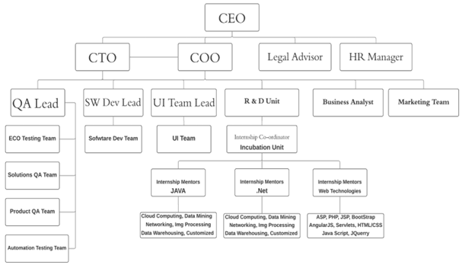
ORGANIZATION STRUCTURE OF THE COMPANY

Slide 6

02
Narration
Web development refers to the creating, building, and maintaining of websites.
It includes aspects such as web design, web publishing, web programming, and database management.
It is the creation of an application that works over the internet i.e. websites.

Slide 7
Front-end technologies
HTML: HTML stands for HyperText Markup Language. It is used to design the front end portion of web pages using markup language. It acts as a skeleton for a website since it is used to make the structure of a website.
CSS: Cascading Style Sheets fondly referred to as CSS is a simply designed language intended to simplify the process of making web pages presentable. It is used to style our website.
JavaScript: JavaScript is a scripting language used to provide a dynamic behavior to our website.
Bootstrap: Bootstrap is a free and open-source tool collection for creating responsive websites and web applications. It is the most popular CSS framework for developing responsive, mobile-first websites. Nowadays, the websites are perfect for all browsers (IE, Firefox, and Chrome) and for all sizes of screens (Desktop, Tablets, Phablets, and Phones).

Slide 8
Back-end technologies
Firebase is a product of Google which helps developers to build, manage, and grow their apps easily.
It helps developers to build their apps faster and in a more secure way. No programming is required on the firebase side which makes it easy to use its features more efficiently.
It provides services to android, ios, web, and unity. It provides cloud storage. It uses NoSQL for the database for the storage of data.

Slide 9

03
Task performed
BLOG APP :
BLOG App provides a hassle-free accessing
of the posted blogs,topics,entries etc.
It is also used for posting the blogs , editing
the blogs , deleting the posted blogs etc.
It is also used for viewing and commenting
the other blogs/posts.

Slide 10
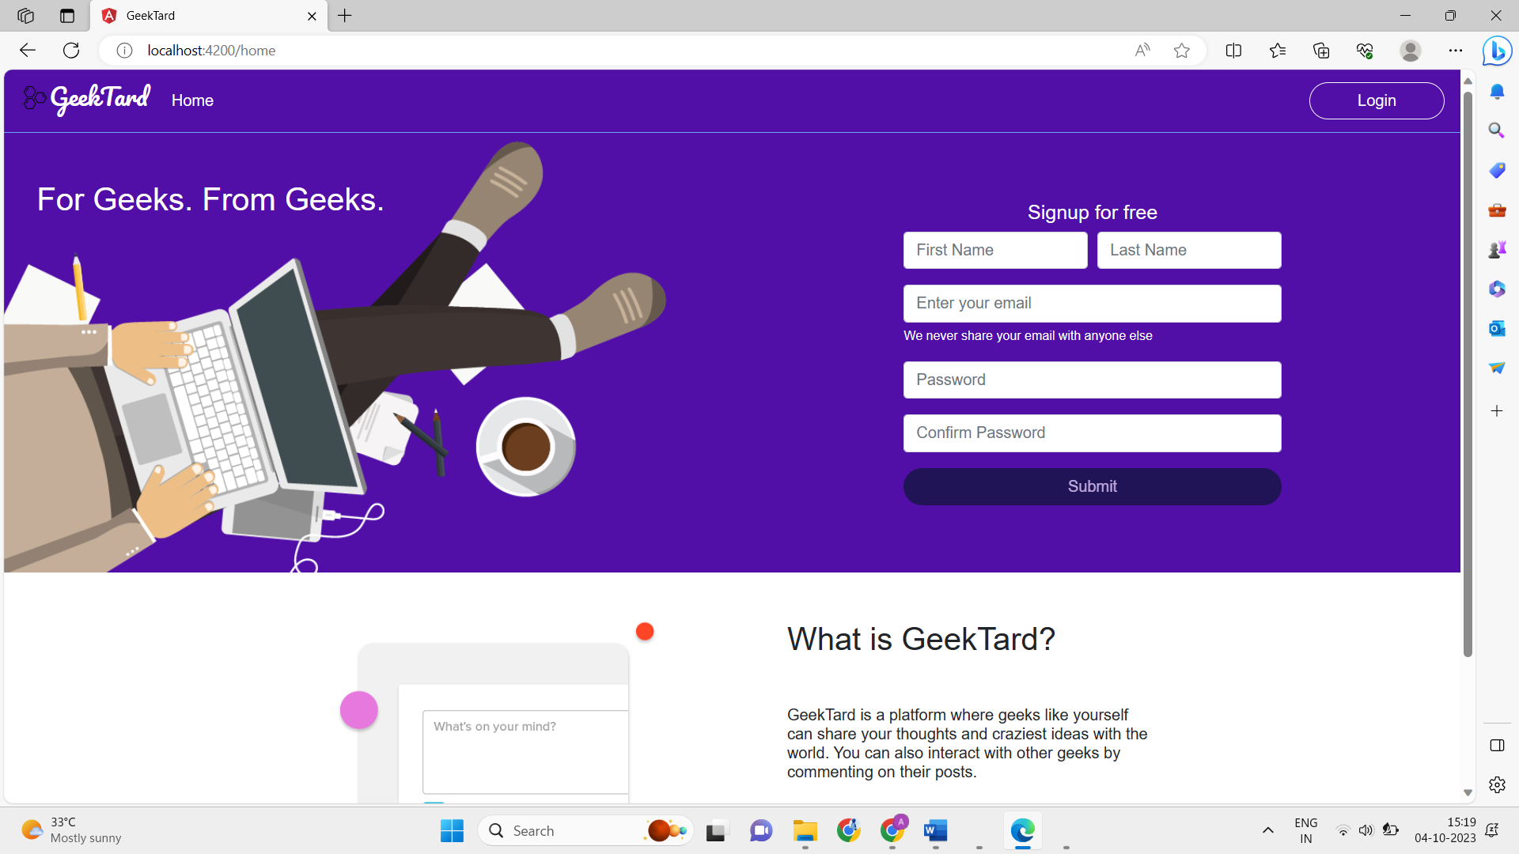
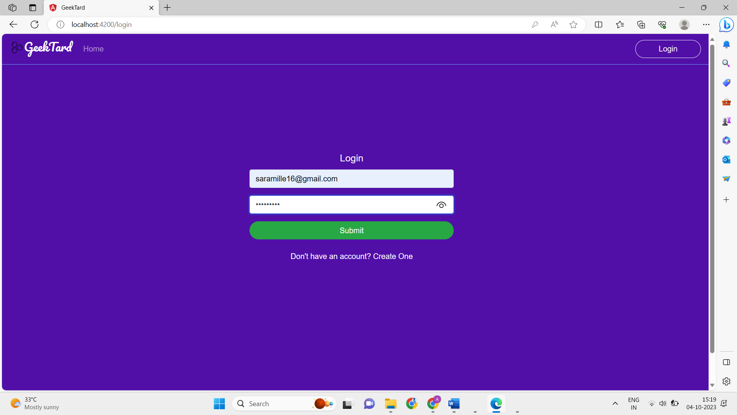
Output screens
Sign in page
Log in page

Slide 11
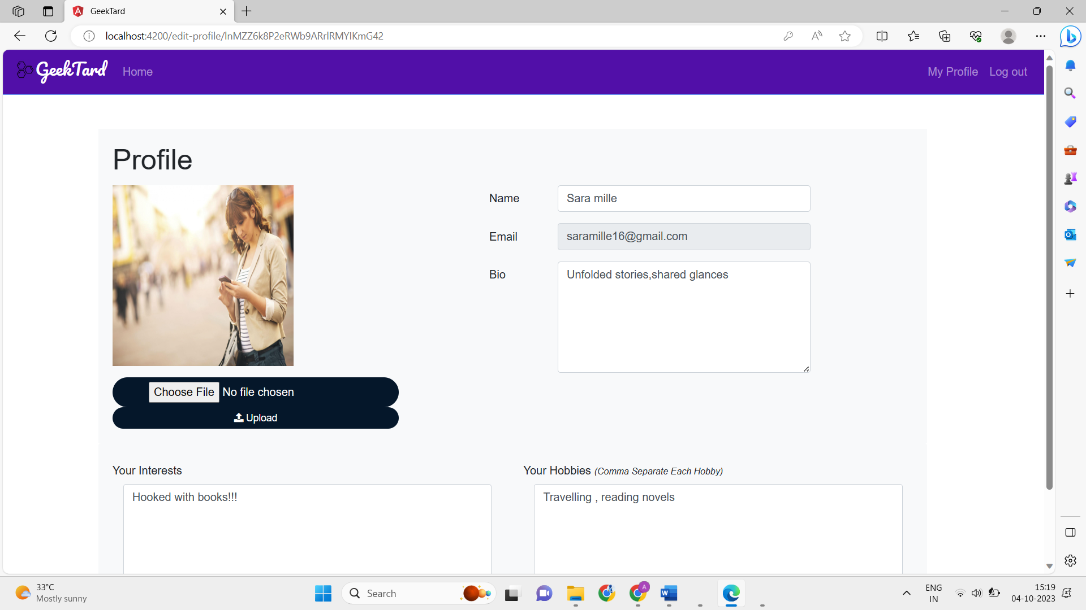
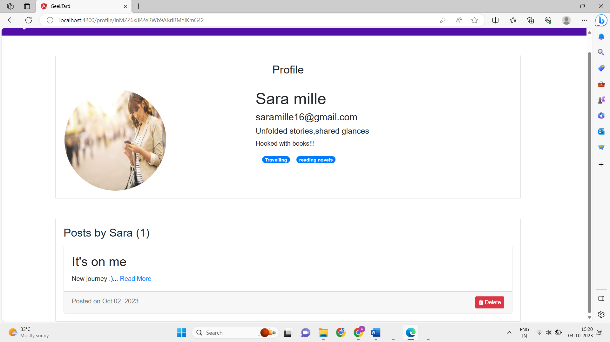
Edit profile
Profile of user

Slide 12
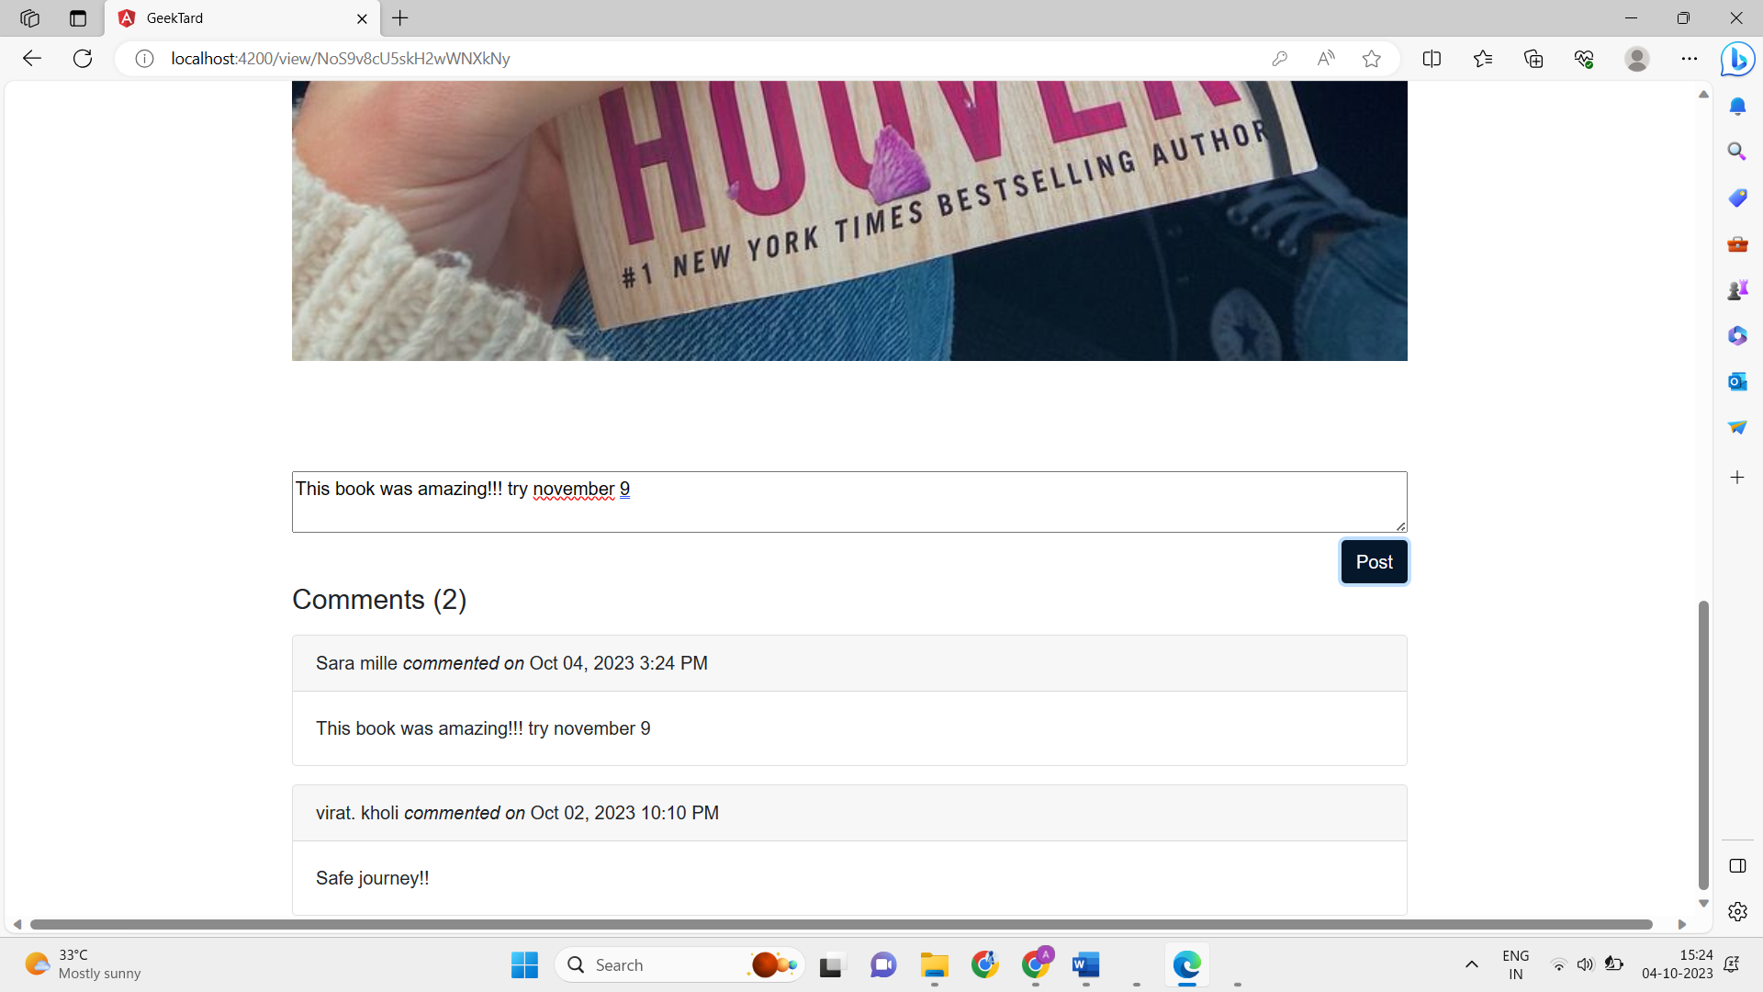
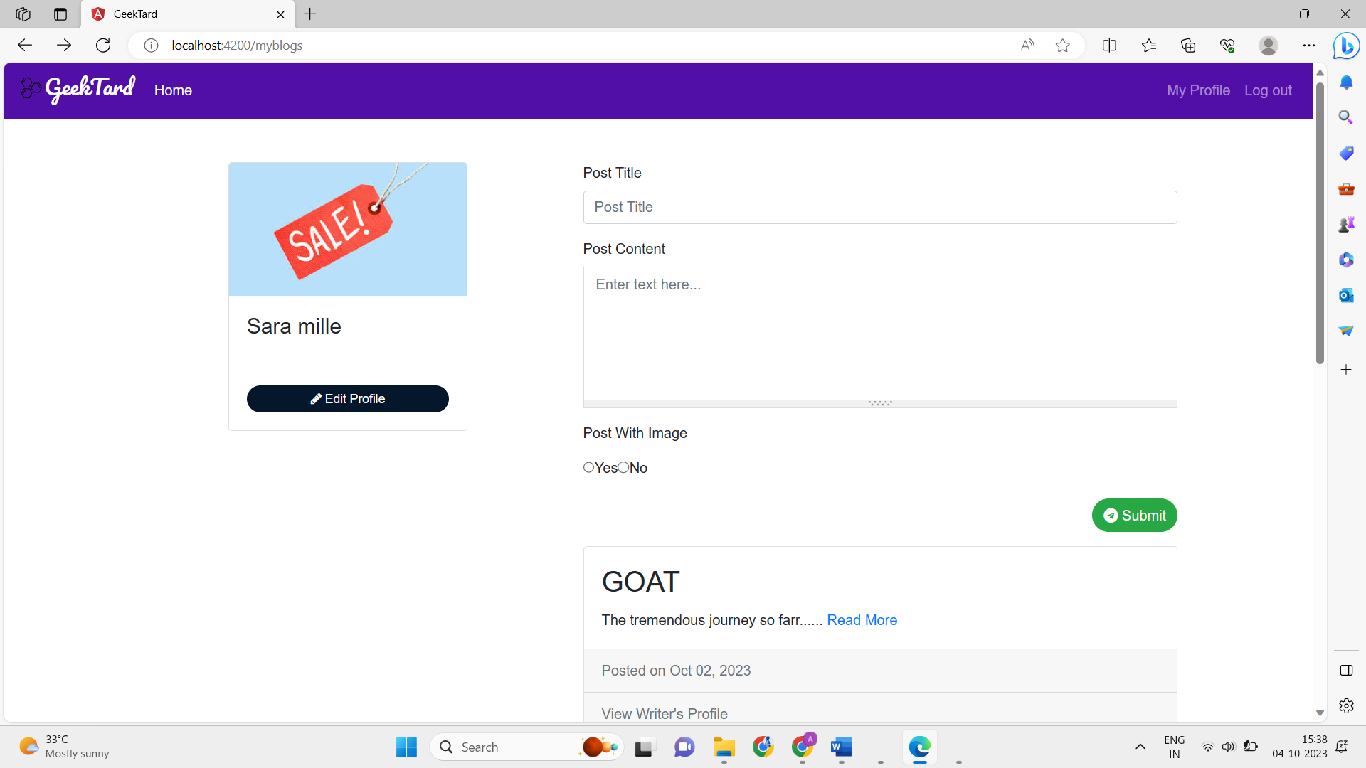
Comment section
Add the posts/blogs

Slide 13
Self evaluation
04
This internship was a monitored work experience that has intentional learning outcomes and goals for me.
Internships focus on personal career development and can be a semester, summer, or even year-long program. I put a thought on how to start our internship. Thus, I need to initially check for our interest in field of software.
This would help me to choose our technology on which I want to work. The technology selection does not only depend on interest but also the how accurate, efficient, modular, scalable etc is the technology.

Slide 14

Conclusion
05
This digital realm becomes a reservoir of collective knowledge, personal anecdotes, and professional insights, enriching the lives of both creators and consumers.
By creating a platform that facilitates the exchange of ideas, the Blog App encapsulates the essence of the information age, where shared narratives bridge gaps and foster understanding in an interconnected world.
As authors craft narratives and readers engage in thoughtful discourse, the app fosters an environment where ideas transcend geographical boundaries.

Slide 15
References
06
www.mysql.com
http://en.wikipedia.org/wiki/Recruitment
www.w3schools.com
www.google.co.in
http://www.recruitmentsystems.com/
http://www.codeproject.com/KB/architecture/OOP_Concepts_and_ manymore.aspx
http://en.wikipedia.org/wiki/Human_resource_management

Slide 16

Social media is all about people
THANK YOU

